Slide 1
Rendering with DirectX 12
By – Rahul Gupta

Slide 2
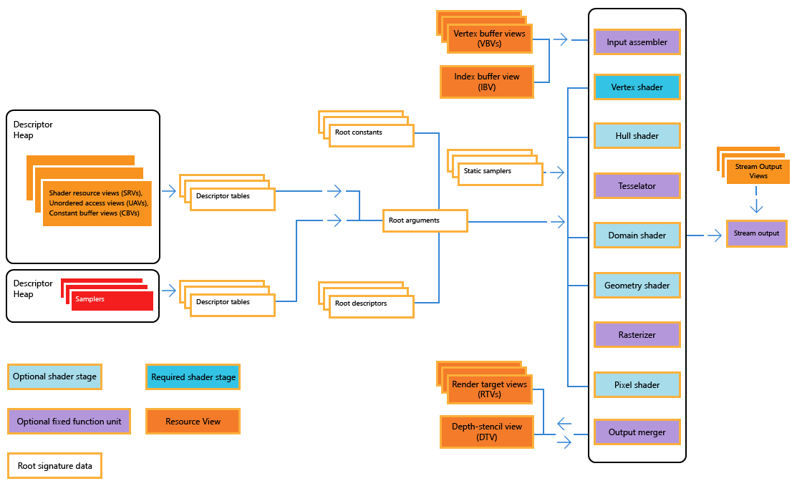
The Direct3D 12 Pipeline
Fig 1. Direct3D 12 Pipeline [1]

Slide 3
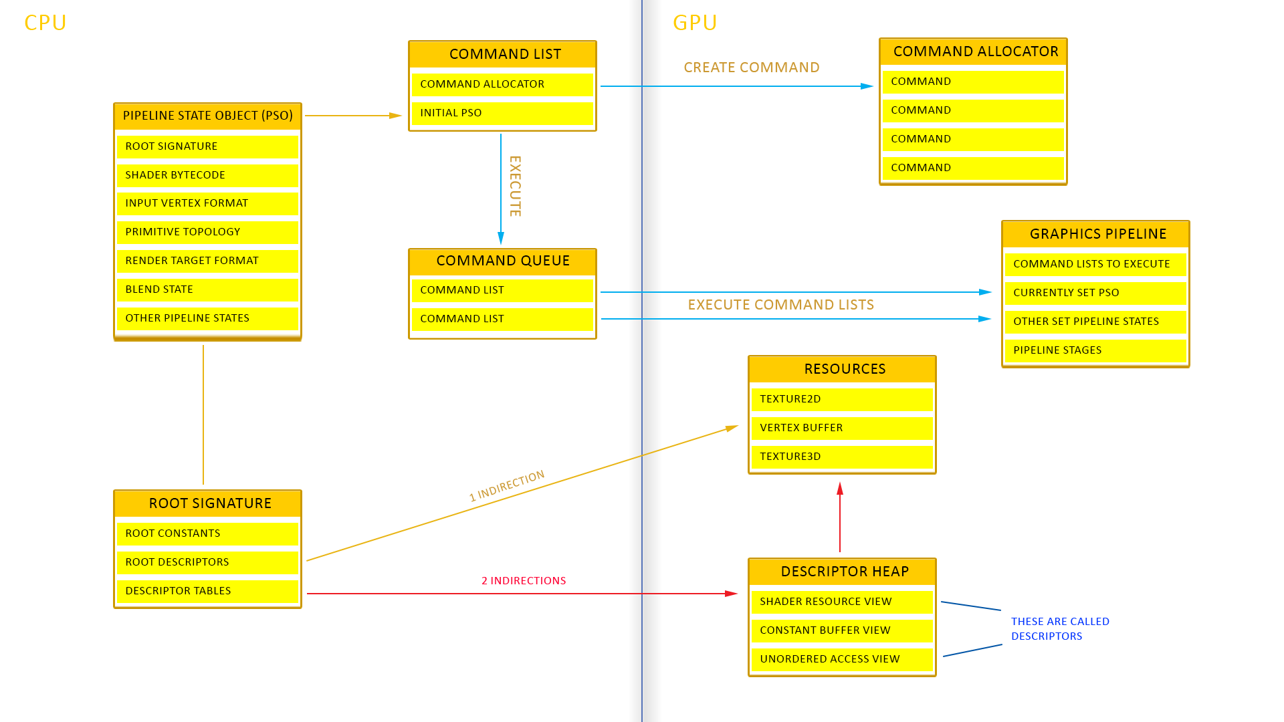
Overview of How Direct3D 12 Works
Fig 2. Overview of How Direct3D 12 Works [2]

Slide 4
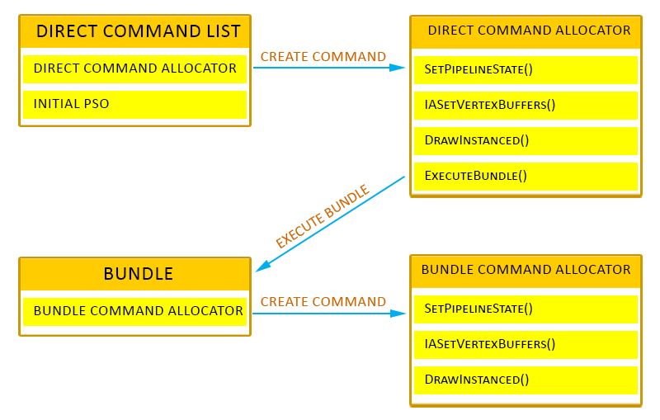
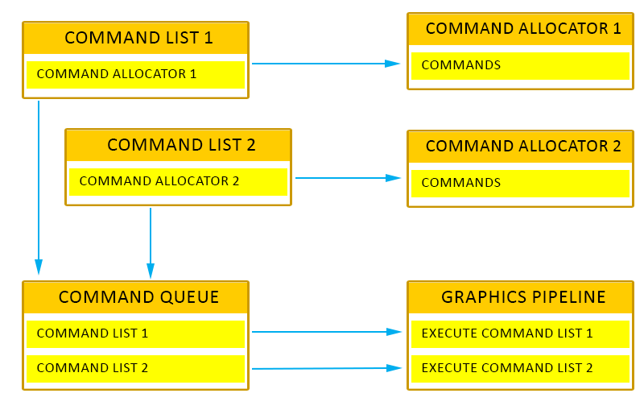
Command Lists & Command Queues
Fig 3. Command Lists [2]
Fig 4. Command Queues [2]
Notes:
Command lists are associated with a Command Allocator, which store the commands on the GPU.
Command Allocators represent the GPU memory that commands from Command Lists and Bundles are stored in.
We use Command Lists to allocate commands we want to execute on the GPU. Commands may include setting the pipeline state, setting resources, transitioning resource states (Resource Barriers), setting the vertex/index buffer, drawing, clearing the render target, setting the render target view, executing bundles (groups of commands), etc.
We use the command queue to submit Command Lists to be executed by the GPU. Command Queues are also used to update resource tile mappings

Slide 5
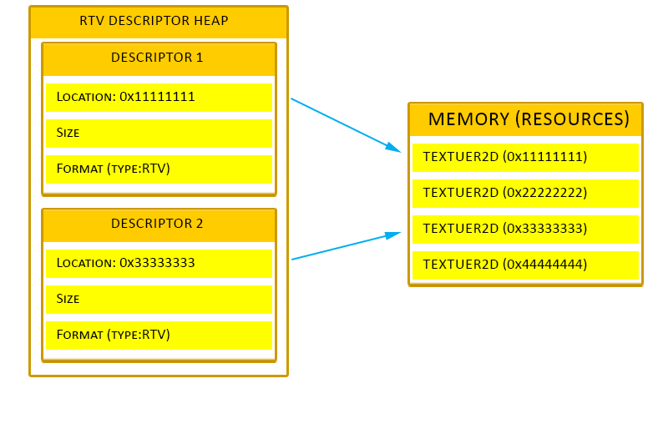
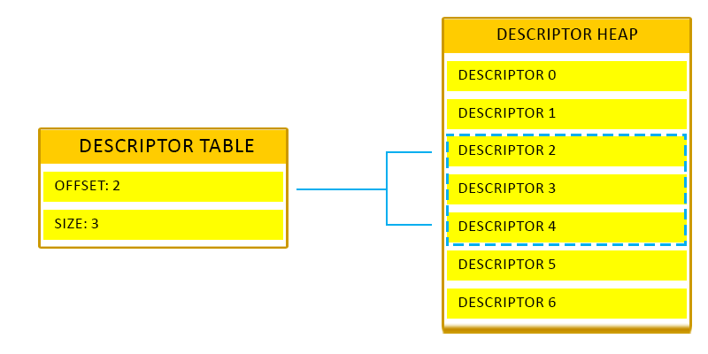
Descriptors & Descriptor Tables
Fig 5. Descriptors (Resource Views) [2]
Fig 6. Descriptor Tables [2]
Notes:
Descriptors are are a structure which tells shaders where to find the resource, and how to interpret the data in the resource
create multiple descriptors for the same resource because different stages of the pipeline may use it differently
Descriptor Heaps are a list of descriptors. They are a chunk of memory where the descriptors are stored.
Samplers cannot go into the same descriptor heaps as resources. Descriptor heaps can also be Shader Visible or Non-Shader Visible. Shader Visible descriptor heaps are heaps that contain descriptors that shaders can access. These types of heaps may include CBV, UAV, SRV, and Sampler descriptors. Non-Shader Visible descriptor heaps are heaps that the shaders cannot reference. These types of heaps include RTV, DSV, IBV, VBV, and SOV resource types.

Slide 6
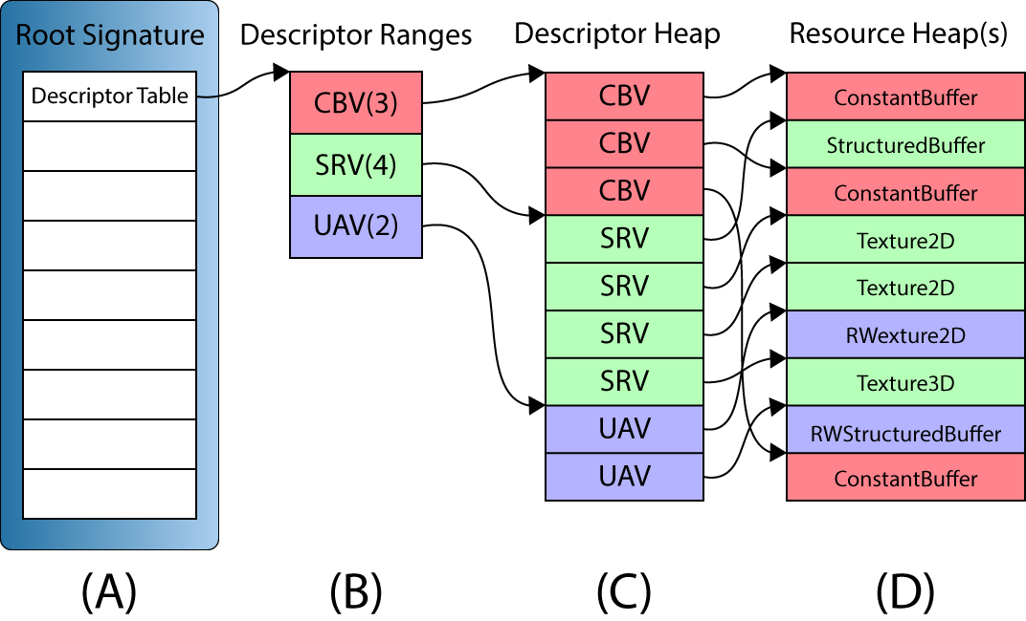
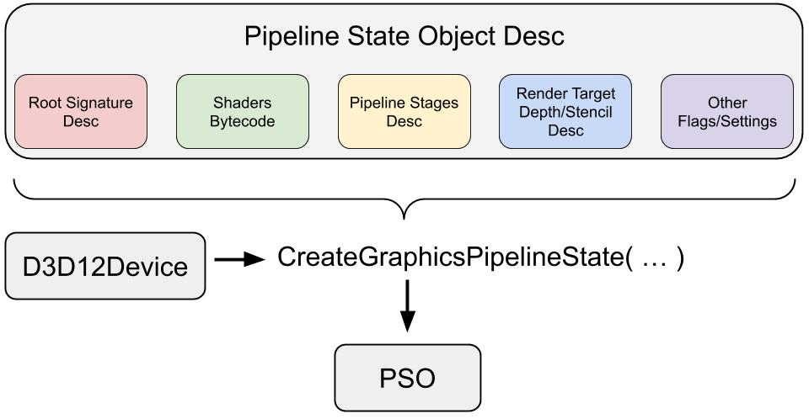
Root Signature & Pipeline State Objects
Fig 7. Root Signature [3]
Fig 8. Pipeline State Objects [3]
Notes:
A root signature is the definition of an arbitrarily arranged collection of descriptor tables (including their layout), root constants and root descriptors.
It is configured by the app and links command lists to the resources the shaders require.
A descriptor table (A) in a root signature defines a set of one or more descriptor ranges (B). The descriptor ranges define a set of consecutive descriptors in a GPU visible descriptor heap (C). The descriptors are views to the GPU resources stored in one or more resource heaps (D).

Slide 7
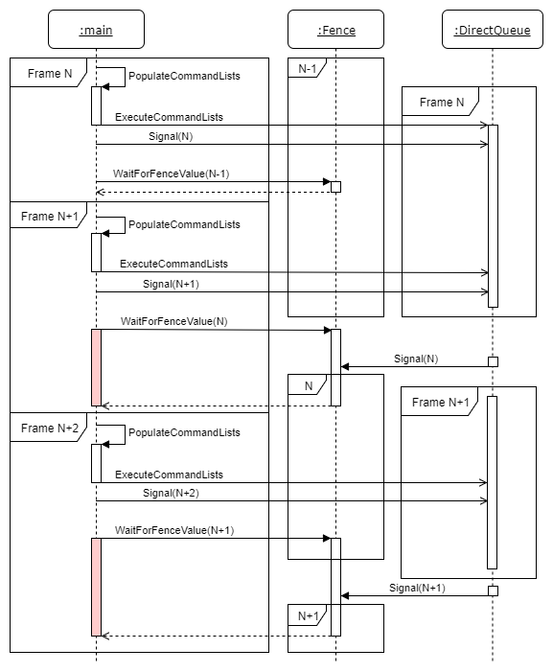
An example of performing GPU synchronization
In this example, the first frame is denoted Frame N. The command lists are executed on the command queue. Immediately after executing the command lists, the queue is signaled with the value N. When the command queue reaches that point, the fence will be signaled with the specified value.
Right after the Signal, there is a WaitForFenceValue command which waits for the previous frame (Frame N-1) to be finished. Since there were no commands in the command queue in Frame N-1, execution continues without stalling the CPU thread.
Then Frame N+1 is built on the CPU thread and executed on the direct command queue. Before the CPU can continue, the command queue has to finish using the resources from Frame N. In this case, the CPU has to wait until signal N is reached which indicates that the command queue is finished with those resources.
Fig 9. An example of performing GPU synchronization [3]
Notes:
In this example, the first frame is denoted Frame N. The command lists are executed on the command queue. Immediately after executing the command lists, the queue is signaled with the value N. When the command queue reaches that point, the fence will be signaled with the specified value.
Right after the Signal, there is a WaitForFenceValue command which waits for the previous frame (Frame N-1) to be finished. Since there were no commands in the command queue in Frame N-1, execution continues without stalling the CPU thread.
Then Frame N+1 is built on the CPU thread and executed on the direct command queue. Before the CPU can continue, the command queue has to finish using the resources from Frame N. In this case, the CPU has to wait until signal N is reached which indicates that the command queue is finished with those resources.

Slide 8
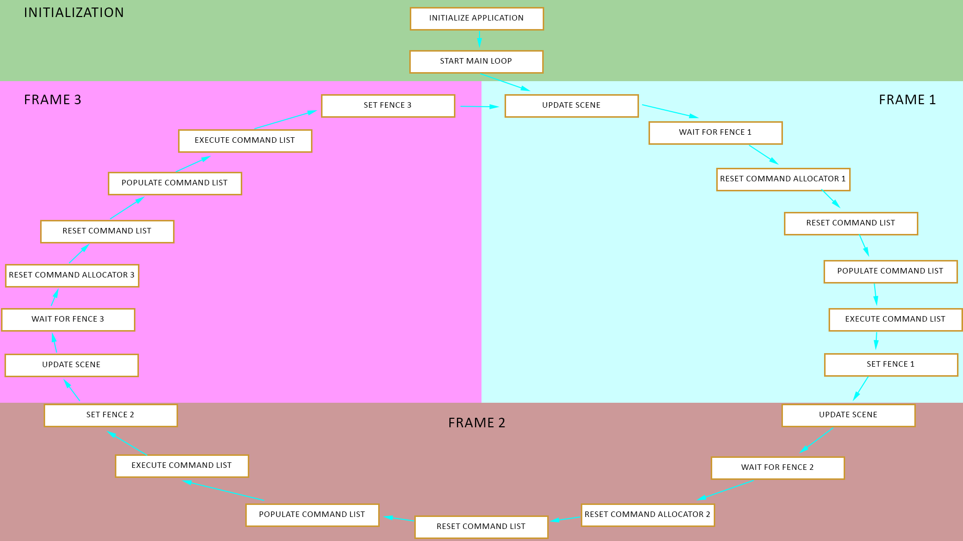
Overview of Application Flow Control for Direct3D 12
Fig 10. Overview of Application Flow Control for Direct3D 12 [2]

Slide 9





Demonstration

Slide 10
Problems Encountered
Managing so many layers of abstracted resources is not an easy task.
Development dependencies such as the new Shader Model 6.0 DXC compiler dll and other helper libraries are specific across the various updates of even the same version of Windows.
Not setting even a single variable correctly will cause the program to crash instantly.
Much easier to leak resources now that we manage the memory ourselves.
Memory should be allocated with various use cases in mind.
Debugging test cases on the Azure pipeline is harder.
Test cases do not get invoked in the order they are typed out but rather in alphabetical order.
The Testing framework deallocates a global memory if the method is the one allocating that global memory.

Slide 11
Postmortem
Original plan was over ambitious
Integrating DirectX 12 Renderer with the existing Engine while not having sufficient knowledge of DirectX 12 was a bad idea.
Changed the plans to fit more along the lines of major learning goals rather than trying to have a great overall architecture as at the end.
Current Status vs Projected Status
The idea for setting up an architecture was scrapped and the policy of getting something on screen first was put into practice more.
Would cut on unnecessary high level architectural stuff and keep it simpler and focus on getting something on screen first.
Focus more on the learning aspect of newer features like DXR, Variable Rate shading and Mesh shaders more.
The Task estimates were accurate enough to get something working and running on screen.

Slide 12
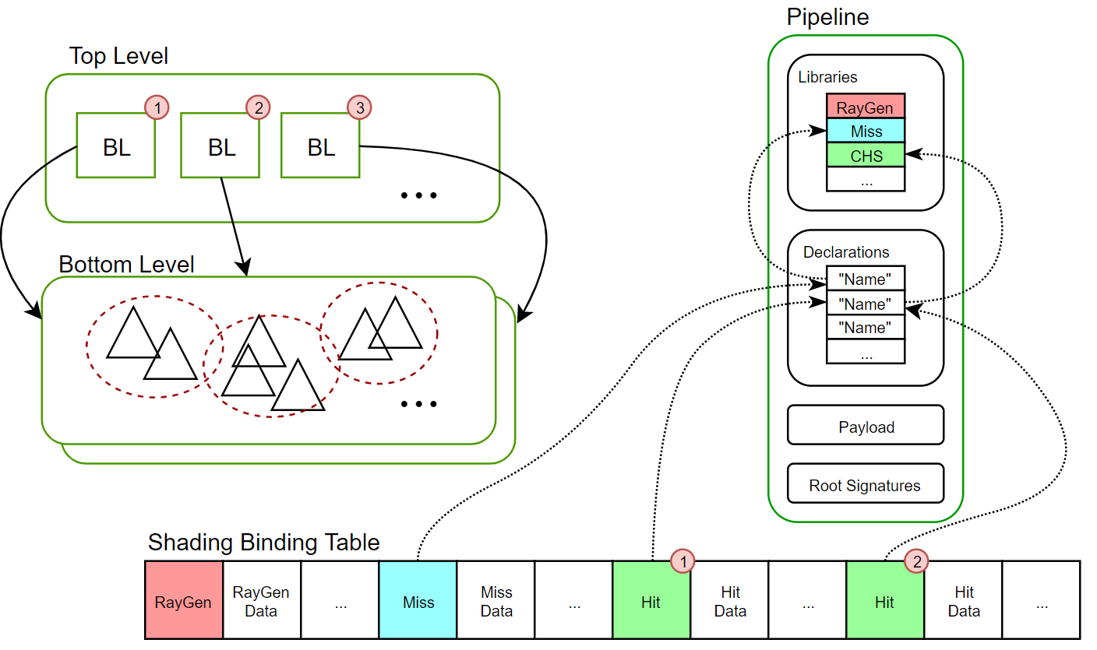
Goals For Final
Get a working understanding of DirectX Raytracing Pipeline
Fig 11. Overview of raytracing building blocks [4]

Slide 13
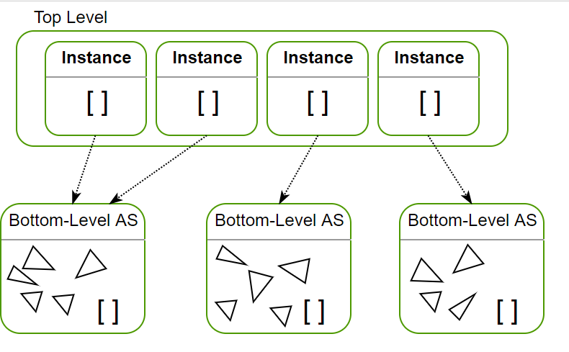
Direct3D 12 Objects Identified For Raytracing
3 main building blocks –
Top-Level Accelerated Structures (TLAS) - contain the object instances, each one with its own transformation matrix
Bottom-Level Accelerated Structures (BLAS) - contains the vertices of the triangle and a top-level AS instancing it once with an identity transform.
Shader Binding Table - linking all the pieces together by indicating which shader programs are executed for which geometry, and which resources are associated with it.
Ray Payload Structure - A user-defined structure that is provided as an inout argument in a TraceRay call, and as an inout parameter in the shader types that may access the ray payload, which include any hit, closest hit, and miss shaders.
Fig 12. Acceleration Structure (AS) [4]

Slide 14
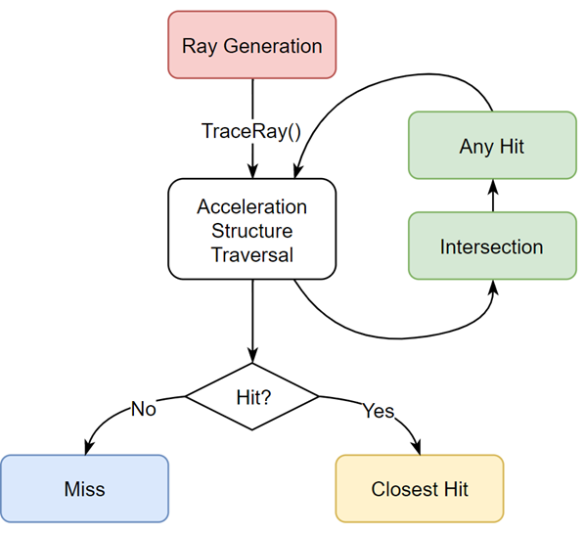
Direct3D 12 Objects Identified For Raytracing
Other Important Structures
Create Ray Generation Signature – The root signature of the Ray generation program indicates the program needs to access the image output and the buffer containing the TLAS.
Create Miss Signature - root signature of the miss shader is also empty since this shader only communicates through the ray payload.
Create Hit Signature - At first, our closest hit program will simply return a color in the payload.
Fig 13. The Raytracing Pipeline [5]

Slide 15
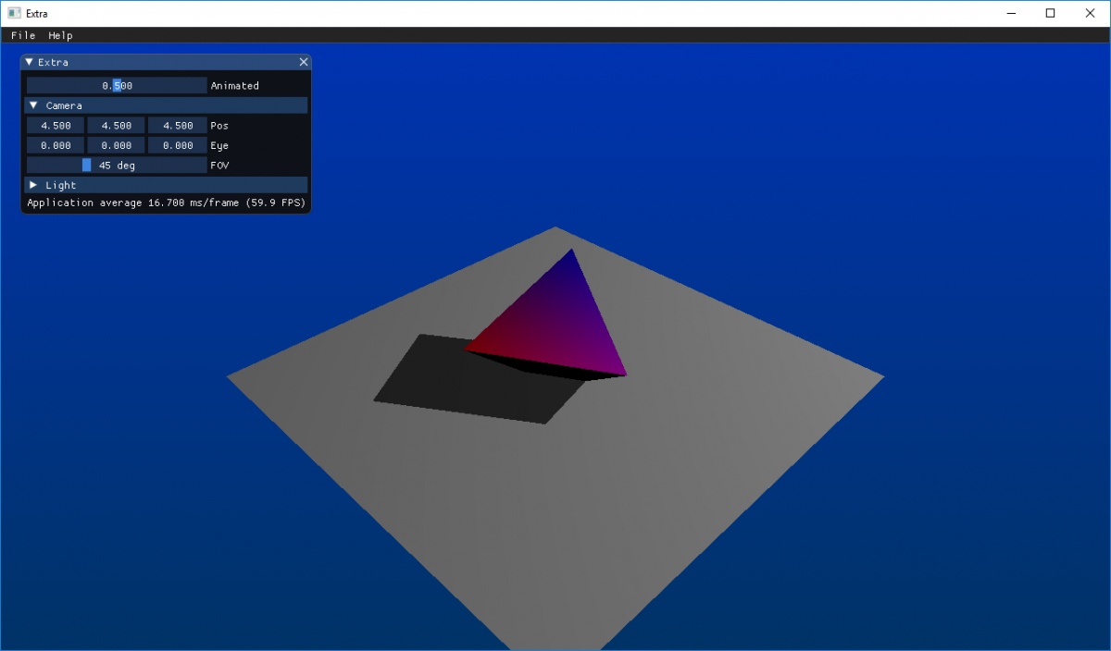
Current Expectations for the Final Scene
Fig 14. Raytraced Lighting Sample [5]

Slide 16
References
https://docs.microsoft.com/en-us/windows/win32/direct3d12/pipelines-and-shaders-with-directx-12
https://www.braynzarsoft.net/viewtutorial/q16390-03-initializing-directx-12
https://www.3dgep.com/learning-directx-12-2/
https://developer.nvidia.com/rtx/raytracing/dxr/dx12-raytracing-tutorial-part-1
https://developer.nvidia.com/rtx/raytracing/dxr/dx12-raytracing-tutorial-part-2

Slide 17

Thank You

